Slide 1
Hadoop - Big Data
Sujeeth Shetty

Slide 2
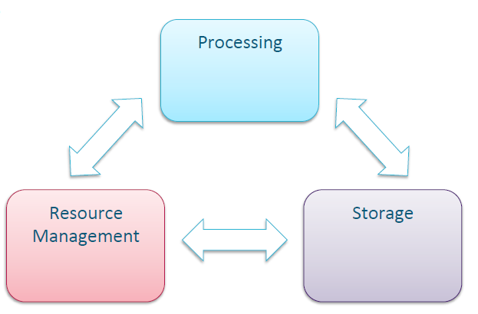
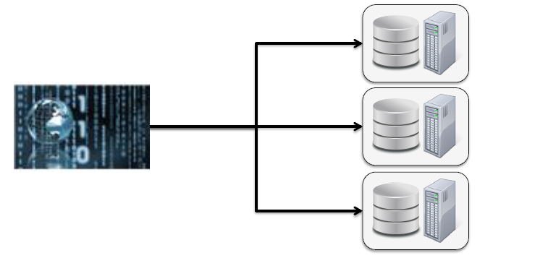
What is Hadoop?
Apache Hadoop is an open source, Java based framework used for storing and processing big data.
It enables big data analytics processing tasks to be broken down into smaller tasks that can be performed in parallel by using an algorithm (like the MapReduce algorithm) and distributing them across a Hadoop cluster.
A Hadoop cluster is a collection of computers, known as nodes, that are networked together to perform these kinds of parallel computations on big data sets.
These three main components of cluster, working together to provide distributed data processing.

Slide 3

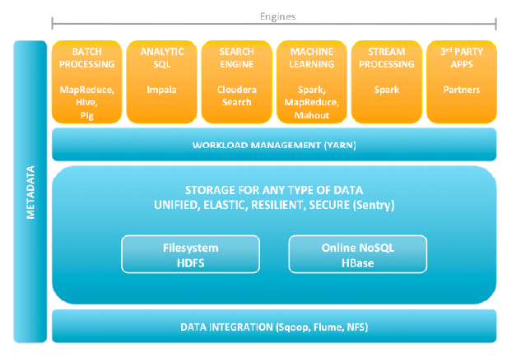
Hadoop Architecture

Slide 4
Core Components of Hadoop Ecosystem
HDFS(Hadoop Distributed File System):
HDFS is a distributed file system designed to run on commodity hardware
HDFS has a NameNode and DataNode. DataNodes are the commodity servers where the data is stored. The NameNode, on the other hand, contains metadata with information on the data stored in the different nodes
YARN (Yet Another resource Negotiator):
YARN is a Hadoop processing layer that contains a Resource Manager and a Job Scheduler
It manages and schedules the resources and decides what should happen in each data node. The central master node that manages all processing requests is called the Resource Manager. The Resource Manager interacts with Node Managers; every slave data node has its own Node Manager to execute tasks.
Map Reduce:
MapReduce is a programming model within Hadoop framework used to access big data stored in HDFS
It facilitates concurrent processing by splitting data into smaller chunks and processing them in parallel on Hadoop servers. It works based on two functions — Map() and Reduce() — that parse the data in a quick and efficient manner.
Notes:
YARN allows the data stored in HDFS (Hadoop Distributed File System) to be processed and run by various data processing engines such as batch processing, stream processing, interactive processing, graph processing and many more. Thus the efficiency of the system is increased with the use of YARN.
MapReduce:
MapReduce facilitates concurrent processing by splitting petabytes of data into smaller chunks, and processing them in parallel on Hadoop commodity servers. In the end, it aggregates all the data from multiple servers to return a consolidated output back to the application.
For example, a Hadoop cluster with 20,000 inexpensive commodity servers and 256MB block of data in each, can process around 5TB of data at the same time. This reduces the processing time as compared to sequential processing of such a large data set.
With MapReduce, rather than sending data to where the application or logic resides, the logic is executed on the server where the data already resides, to expedite processing. Data access and storage is disk-based—the input is usually stored as files containing structured, semi-structured, or unstructured data, and the output is also stored in files.

Slide 5
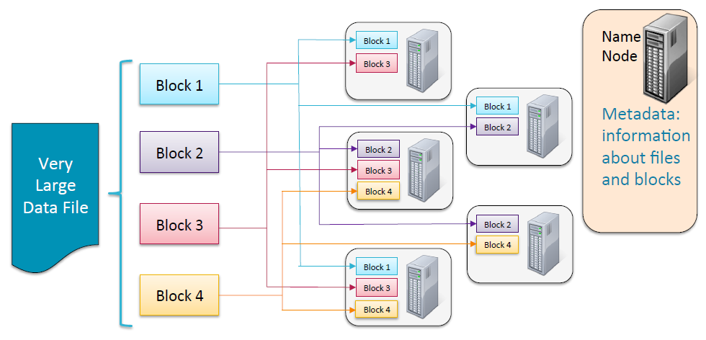
How Files are Stored?
Data Files are split into 128 MB blocks which are distributed at load time
Each block is replicated on multiple data nodes(default 3x)
NameNode stores metadata

Slide 6
Data Ingest Tools
Apache Sqoop:
extensively used to transfer large amounts of data from Hadoop to the relational database servers and vice-versa
Sqoop supports data imported into following services – HDFS, Hive, HBase etc.
Sqoop uses MapReduce to import and export the data, which provides parallel operation as well as fault tolerance.
Apache Flume
Apache Flume is a system used for moving massive quantities of streaming(unstructured) data into HDFS.
Collecting log data present in log files from web servers and aggregating it in HDFS for analysis, is one common example use case of Flume.
Flume is unidirectional

Slide 7
Data Processing
Apache Spark:
Apache Spark is lightning fast, uses in-memory(RAM) computing systems whereas Hadoop uses local memory space to store data
Spark not only supports ‘MAP’ and ‘reduce’. It also supports Machine learning (ML), Graph algorithms, Streaming data, SQL queries, etc.
Apache Pig:
Apache Pig is an abstraction over MapReduce. It is a tool/platform which is used to analyze larger sets of data representing them as data flows.
To write data analysis programs, Pig provides a high-level language known as Pig Latin
Using Pig Latin, programmers can perform MapReduce tasks easily without having to type complex codes in Java.

Slide 8
Data Analysis Tools
Apache Hive:
Hive is a data warehouse infrastructure tool to process structured data in Hadoop. It resides on top of Map Reduce to summarize Big Data and makes querying and analyzing easy.
It is a platform used to develop SQL(HiveQL) type scripts to do MapReduce operations.
Ideally used for bath processing
Cloudera Impala
Impala and Hive are both tools that provide SQL Querying of data stored in HDFS/Hbase
Uses Impala SQL and query latency is measured in milliseconds
SQL engine offers 5x to 50x better performance, so its ideal for interactive queries and data analytics

Slide 9
Hadoop File Formats
AVRO Format:
Apache Avro is a language-neutral data serialization system
It uses JSON for defining data types and protocols and serializes data in a compact binary format.
it’s a row-based format, it’s better to use when all fields needs to be accessed
Suitable for write intensive operation
Parquet Format:
it’s a column-based format, it’s better to use when you only need to access specific fields
Each data file contains the values for a set of rows
Suitable for data exploration — read intensive, complex or analytical querying, low latency data

Slide 10
Thank you!

